Slide 1



Scaling Quantum Error Mitigation in the Age of Distributed Quantum Computation
by María Gragera Garcés
Notes:
Dqc in the context of EM

Slide 2
Talk structure
DQC the Background
DQC errors: What breaks down
Our current research in DQEM
Conclusions
Maria Gragera Garces | WERSHOP 2025 | NYU

Slide 3
DQC the Background
Maria Gragera Garces | WERSHOP 2025 | NYU

Slide 4
“if you are building things for tomorrow’s quantum computers you are building things for distributed quantum computers”
Maria Gragera Garces | WERSHOP 2025 | NYU

Slide 5

What is DQC?
Network
Scalability
Qubit Capacity Expansion
(Heterogeneous) Hardware Integration
Computation + Communication
Problem
Maria Gragera Garces | WERSHOP 2025 | NYU

Slide 6
What counts as “DQC”
Quantum devices that can individually perform quantum computations that cannot be classically simulable, are separated spatially, and are interconnected with each other via quantum channels
Multiple quantum chips within a single device, performing a joint quantum computation and communicating via quantum channels under a shared classical control system (aka I’ll permit shared memory access *for now*).
Separate quantum computers interconnected via a local quantum network, enabling quantum state transfer and entanglement distribution to perform distributed algorithms (HPC like cluster applications).
Long-range quantum communication (quantum internet like stuff) coordinating remote quantum nodes with the purpose of quantum computation.
Maria Gragera Garces | WERSHOP 2025 | NYU

Slide 7
Today
Expectation
Distributed Quantum Computing
Error correction
Error mitigation
Past
Future
NISQ
Logical qubit(s)
MegaQuop

Slide 8
Reality
EM + EC
Error mitigation
NISQ
Past
Future
Logical qubit(s)
MegaQuop

Slide 9
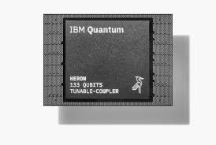
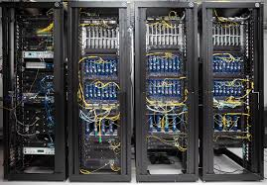
Distributed Quantum Computing
EM + EC
Error mitigation
NISQ
Past
Future
Logical qubit(s)
MegaQuop
Notes:
Xanadu aurora
9 qubit chips riuetti
Heron

Slide 10

How do we DQC?
Problems
Algorithms
Subroutines
Models
Computations
Maria Gragera Garces | WERSHOP 2025 | NYU

Slide 11
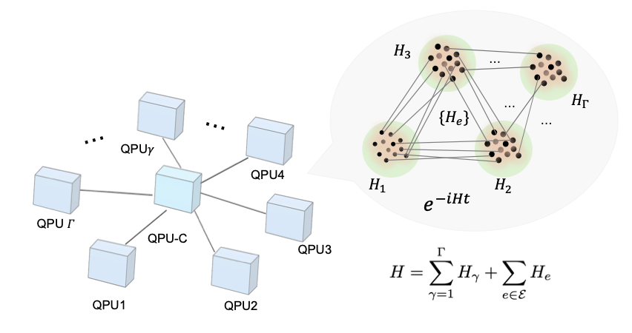
How do we DQC?
Problems
Algorithms
Subroutines
Models
Feng, Tianfeng, et al. "Distributed Quantum Simulation." arXiv preprint arXiv:2411.02881 (2024).
Maria Gragera Garces | WERSHOP 2025 | NYU

Slide 12
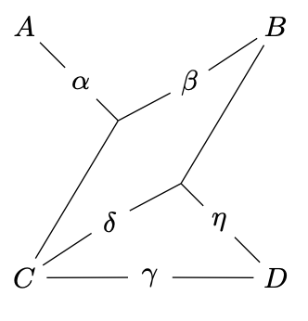
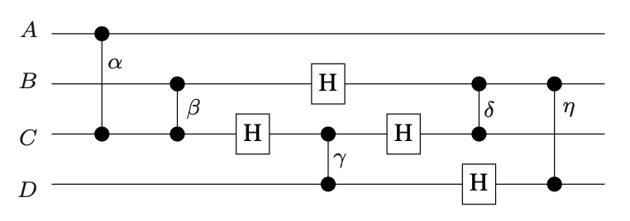


How do we DQC?
Problems
Algorithms
Subroutines
Models
Hypergraph partitioning heuristics
Heunen, Christiaan, and Pablo Andres Martinez. "Automated distribution of quantum circuits." Physical Review A 100 (2019): 032308.
Maria Gragera Garces | WERSHOP 2025 | NYU

Slide 13
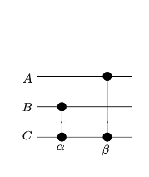
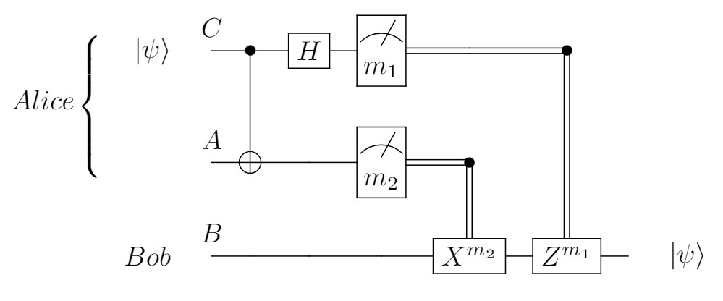
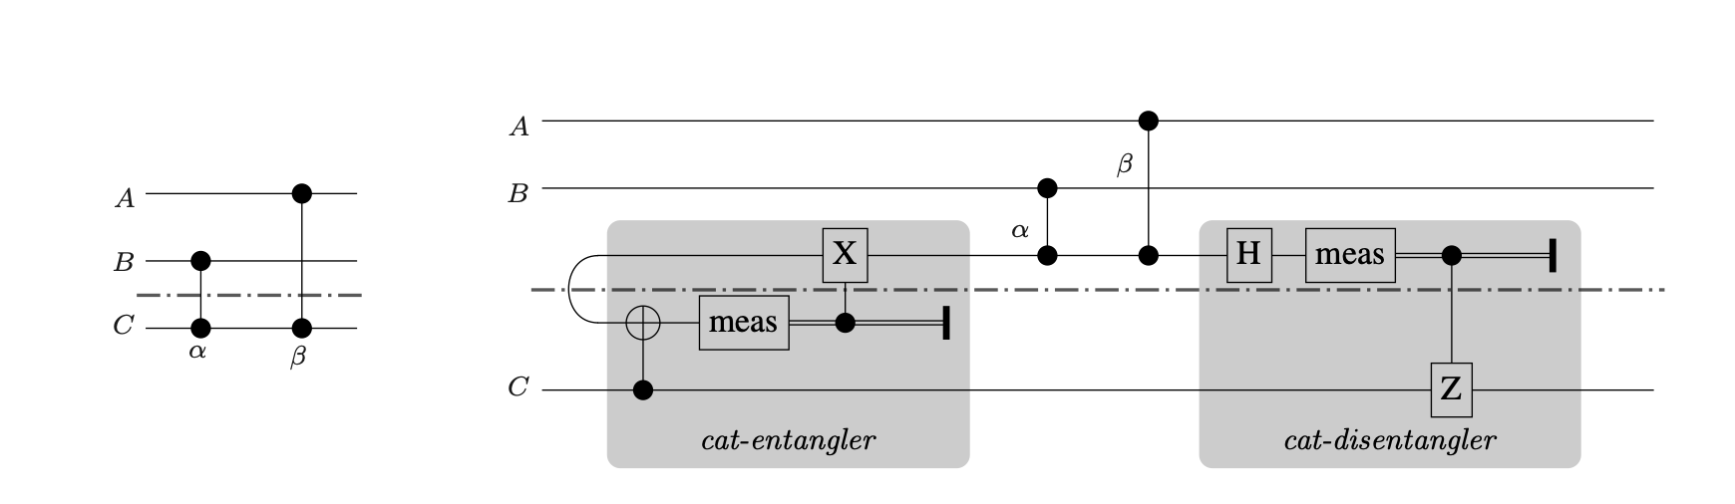
How do we DQC?
Problems
Algorithms
Subroutines
Models
Teleportation protocol(s)
Non local gates
Maria Gragera Garces | WERSHOP 2025 | NYU

Slide 14
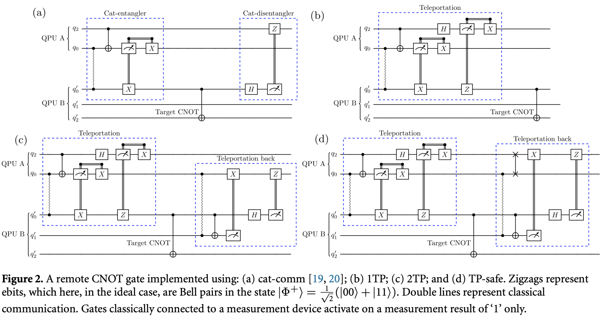
Primitives
Campbell, K., A. Lawey, and M. Razavi. "Quantum data centres: a simulation-based comparative noise analysis." Quantum Science and Technology 10.1 (2024): 015052.
Maria Gragera Garces | WERSHOP 2025 | NYU

Slide 15
DQC errors: What breaks down

Slide 16

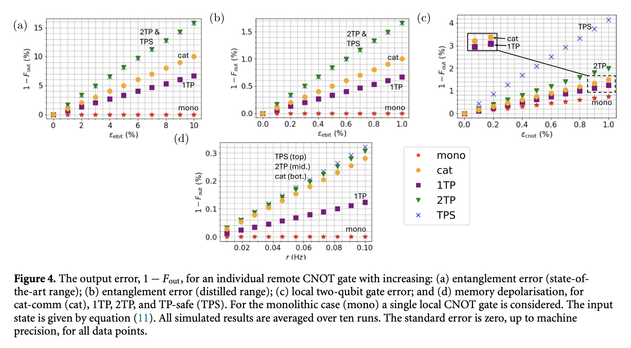
The weight of errors
What is the bigger problem? Local errors or communication errors?
Communication (entanglement)
Local noise
Campbell, K., A. Lawey, and M. Razavi. "Quantum data centres: a simulation-based comparative noise analysis." Quantum Science and Technology 10.1 (2024): 015052.
Maria Gragera Garces | WERSHOP 2025 | NYU
Notes:
Explanation visual

Slide 17
Maria Gragera Garces | WERSHOP 2025 | NYU

Slide 18
The weight of errors
What is the bigger problem? Local errors or communication errors?
Communication (entanglement)
Local noise
Maria Gragera Garces | WERSHOP 2025 | NYU
Notes:
Order of magnitude

Slide 19
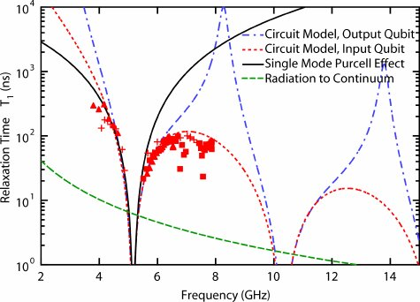
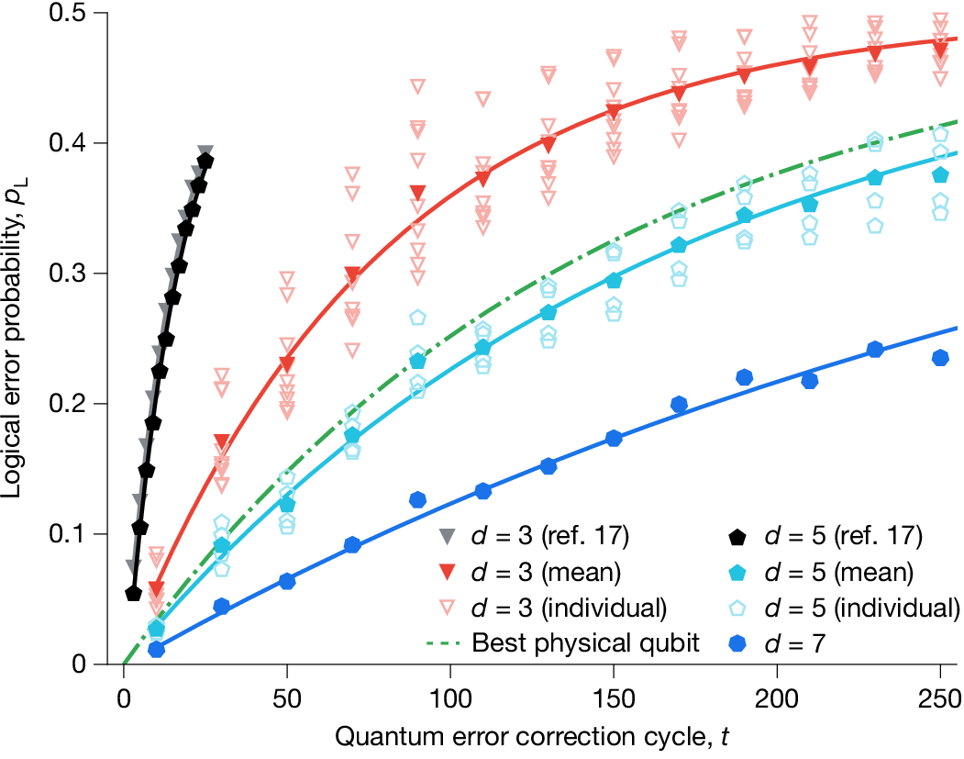
Synchronization lag
Temporal drift can break assumptions which rely on tightly controlled models.
Houck, Andrew Addison, et al. "Controlling the spontaneous emission of a superconducting transmon qubit." Physical review letters 101.8 (2008): 080502.
Acharya, Rajeev, et al. "Quantum error correction below the surface code threshold." Nature (2024).
Maria Gragera Garces | WERSHOP 2025 | NYU

Slide 20





Heterogeneous landscape
Classical computer
Quantum computer
Redundant mitigation
Heterogeneous noise profiles
Overhead from classical coordination
Maria Gragera Garces | WERSHOP 2025 | NYU

Slide 21
Compilation Choices: open questions
QPU1
QPU2
How do we know which partitioning strategy is optimal in advance?
Maria Gragera Garces | WERSHOP 2025 | NYU

Slide 22
Vertical vs Horizontal cuts: a quick vocab sidetrack
Telegate
Teledata
Maria Gragera Garces | WERSHOP 2025 | NYU

Slide 23
Vertical vs Horizontal cuts: a quick vocab sidetrack
Telegate
Teledata
Maria Gragera Garces | WERSHOP 2025 | NYU

Slide 24
Vertical vs Horizontal cuts
Telegate
Teledata
Maria Gragera Garces | WERSHOP 2025 | NYU

Slide 25

Vertical vs Horizontal cuts
Telegate
Teledata
Maria Gragera Garces | WERSHOP 2025 | NYU

Slide 26
“quantum compilers should be noise aware”
Maria Gragera Garces | WERSHOP 2025 | NYU

Slide 27

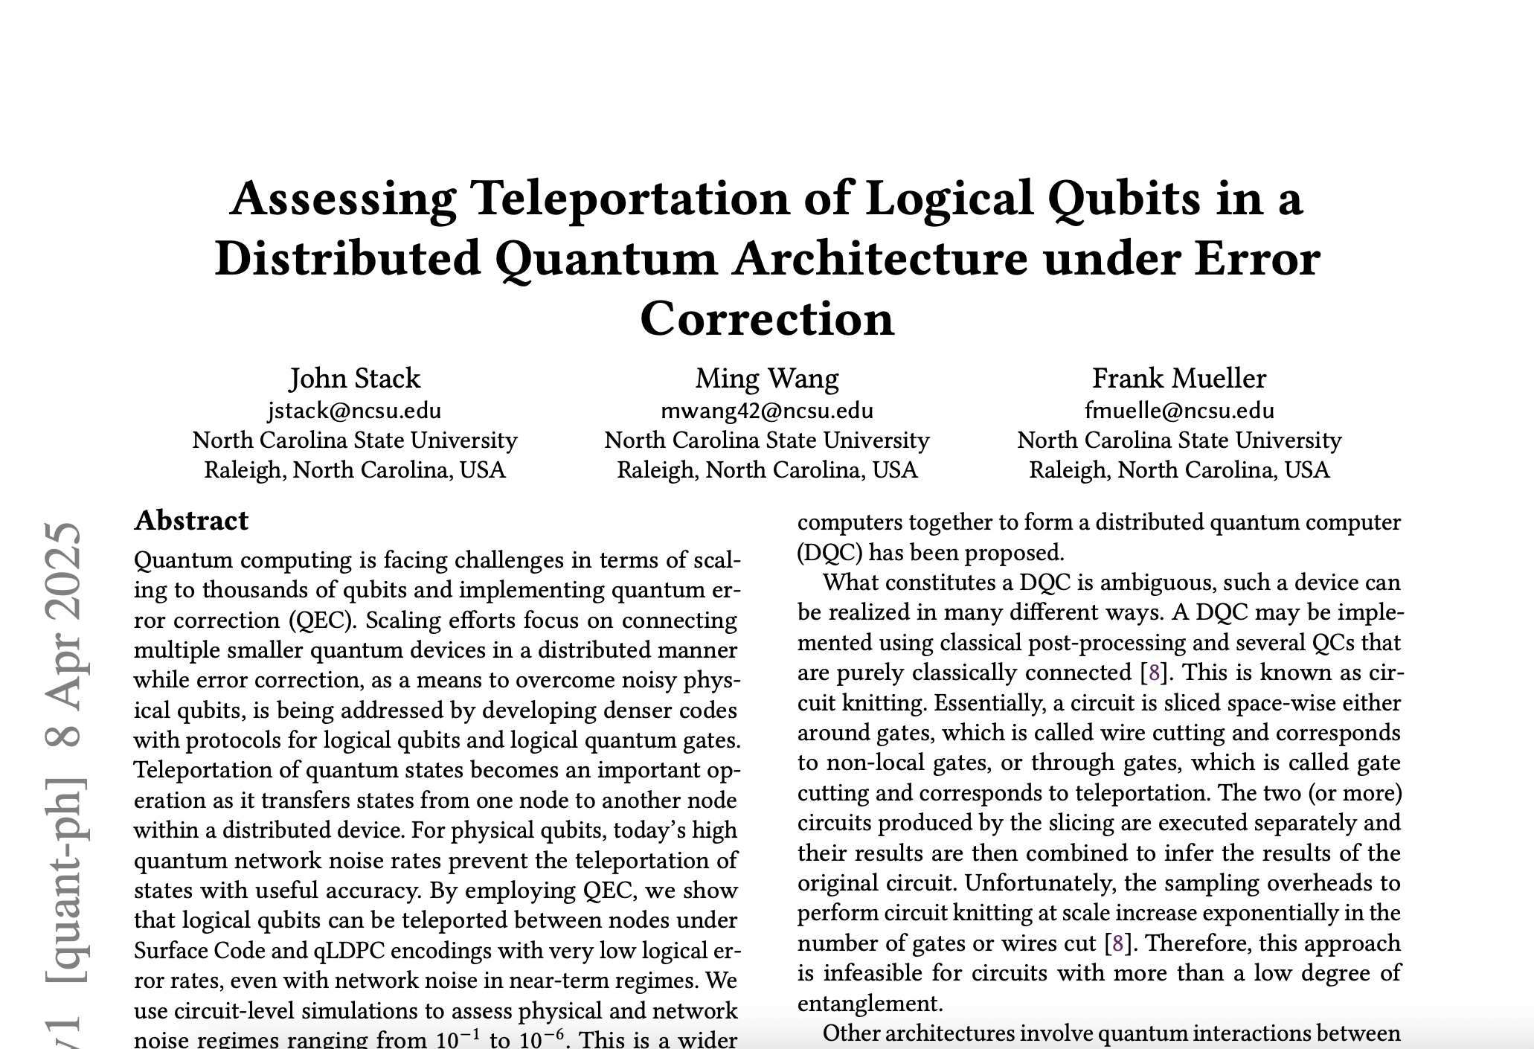
Vertical vs Horizontal cuts
Telegate
Teledata
+100%
arXiv: 2504.05611
Notes:
Open questions: correlator decoding problem, decoder used

Slide 28
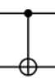
Primitive priorities
Maria Gragera Garces | WERSHOP 2025 | NYU

Slide 29
Primitive priorities
17
17
2
25
26
Maria Gragera Garces | WERSHOP 2025 | NYU

Slide 30
Primitive priorities
17
17
25
26
Maria Gragera Garces | WERSHOP 2025 | NYU

Slide 31
QEM Techniques in a Distributed World
Maria Gragera Garces | WERSHOP 2025 | NYU

Slide 32

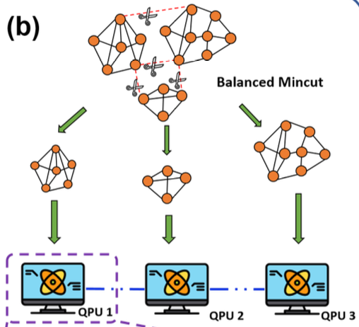

Noise-aware sampling in distribution today
Error mitigation: noise-aware compilation points the circuit to the best qubits (low error from calibration data), skip the bad ones, and run the same QAOA subcircuit across multiple clean qubit blocks (multi-sampling).
Chen, Kuan-Cheng, et al. "Noise-aware distributed quantum approximate optimization algorithm on near-term quantum hardware." 2024 IEEE International Conference on Quantum Computing and Engineering (QCE). Vol. 2. IEEE, 2024.
Maria Gragera Garces | WERSHOP 2025 | NYU
Notes:
Rudimentary
Routing
Calibration data

Slide 33
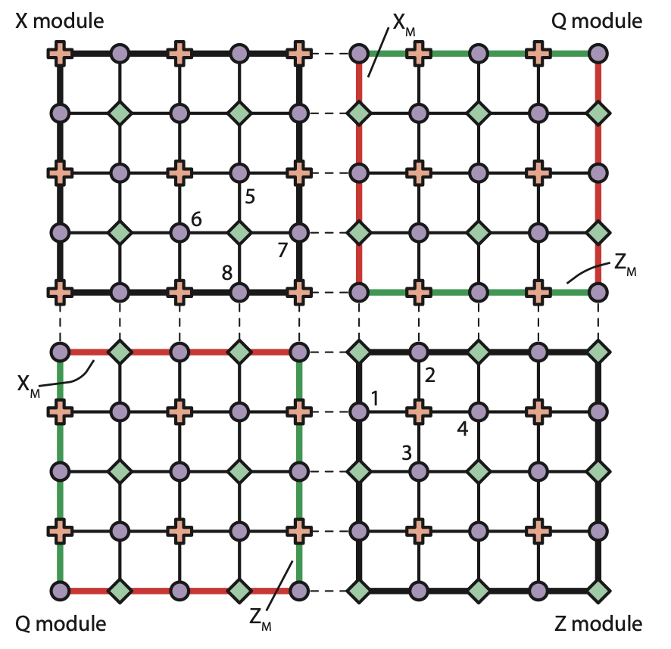
How bad can teleportation noise be?
Module size: 1 logical qubit per qpu -> 8 physical qubits
Inter-module error threshold: 1.65%-9.9%
(To achieve logical error rate 10^-12)
Intra-module error threshold: 0.1%
Li, Ying, and Simon C. Benjamin. "Hierarchical surface code for network quantum computing with modules of arbitrary size." Physical Review A 94.4 (2016)
Maria Gragera Garces | WERSHOP 2025 | NYU
Notes:
My way of cutting up

Slide 34

What happens to error mitigation techniques when you distribute?
Let’s look at some simulation results!
Local noise: 0 - 0.4 (probability that the output is replaced by a random Pauli error)
Telecom noise: 100 to 120% of local noise
Partitions: 2,4
Circuits: 20 logical qubits
Maria Gragera Garces | WERSHOP 2025 | NYU

Slide 35
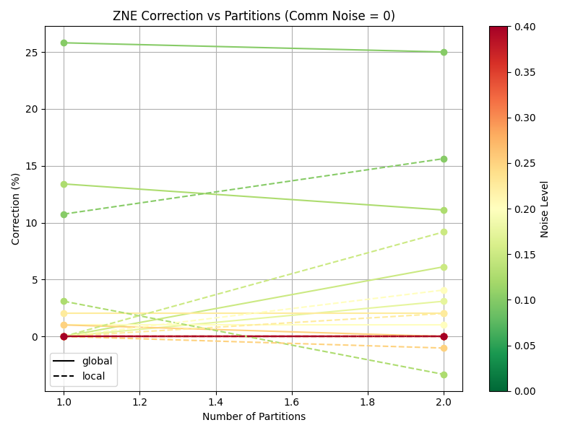
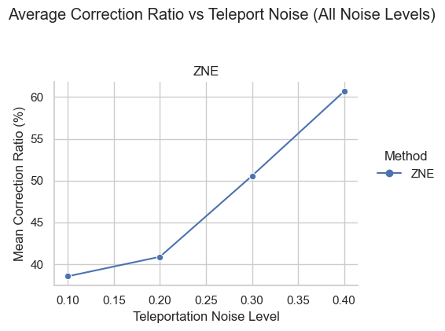
ZNE in a Distributed World: Teleportation noise
Maria Gragera Garces | WERSHOP 2025 | NYU
Notes:
Teleportation noise is sustainable even with high intra-device error up to 0.2 depolarizing noise. Beyond that things get nasty.

Slide 36
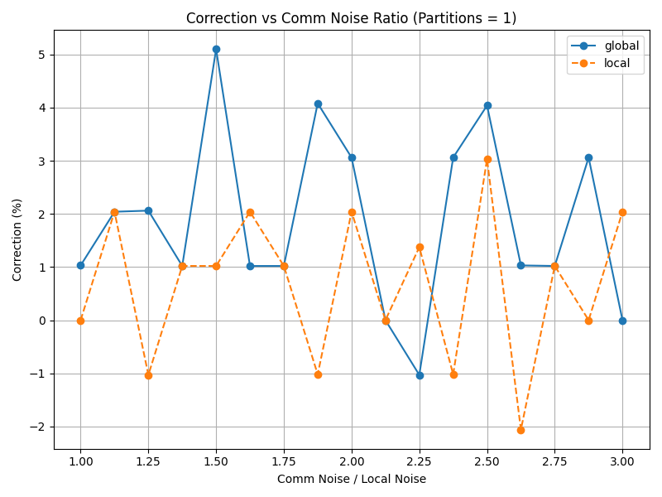
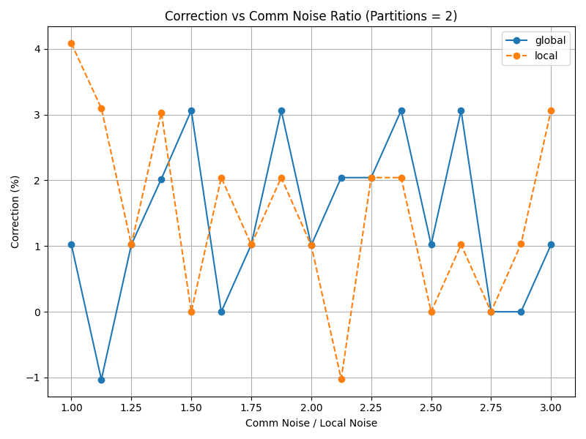
Local vs Global folding corrections under partitioning
Maria Gragera Garces | WERSHOP 2025 | NYU
Notes:
My way of cutting up

Slide 37
Bottlenecks
Simple simulators cannot uphold realistic distributed circuits (realistic benchmarks are too large)
There are no accessible distributed quantum systems where we can direct workloads straightforwardly for testing
?
Maria Gragera Garces | WERSHOP 2025 | NYU

Slide 38
How we are doing it:
QEM Techniques in a Distributed World
Maria Gragera Garces | WERSHOP 2025 | NYU

Slide 39
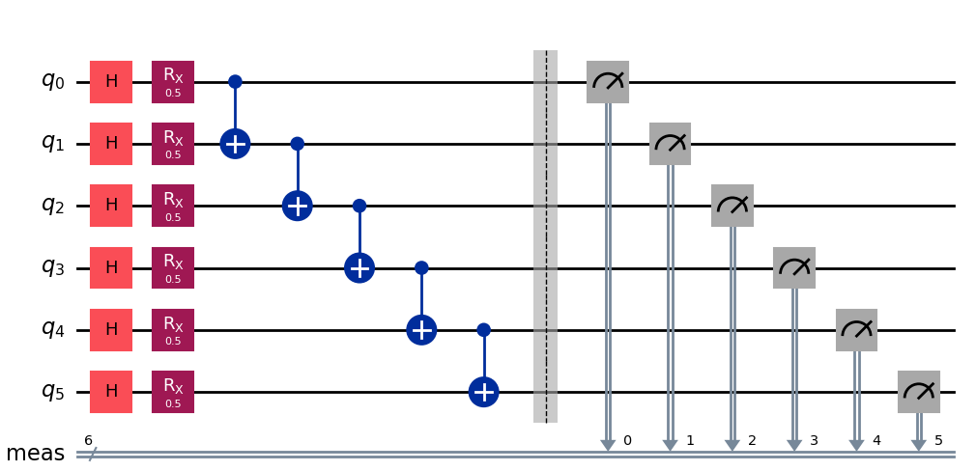

Ongoing work
Monolithic Qiskit code
HDH partitioning
Device tests
Distributed Qiskit code
EM implementation
Maria Gragera Garces | WERSHOP 2025 | NYU

Slide 40
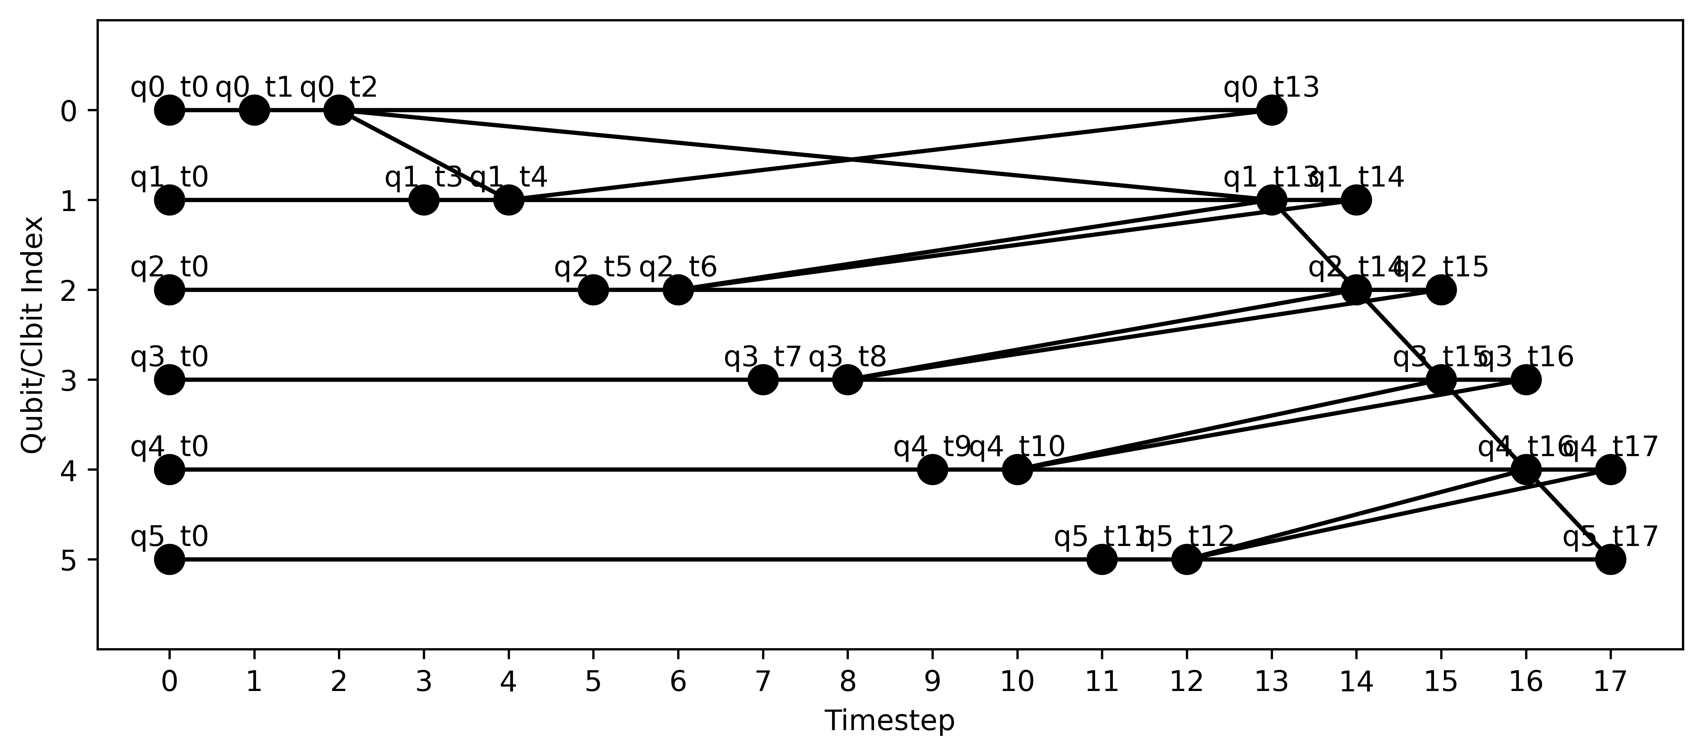
hdh = from_qiskit(qc)
hdh_cut = compute_cut(hdh, num_parts = 2)
Monolithic Qiskit code
HDH partitioning
Distributed Qiskit code
EM implementation
Device tests
Maria Gragera Garces | WERSHOP 2025 | NYU

Slide 41
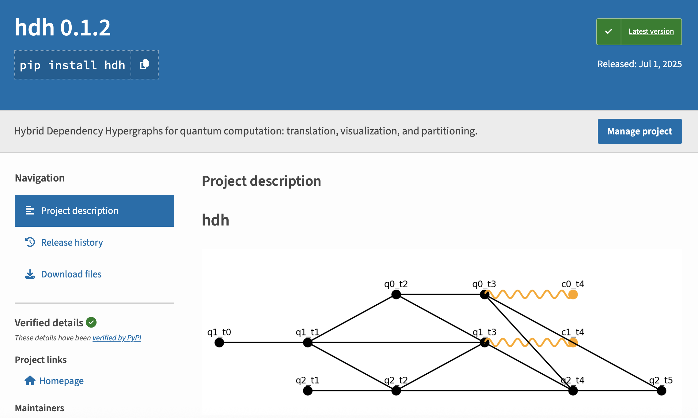
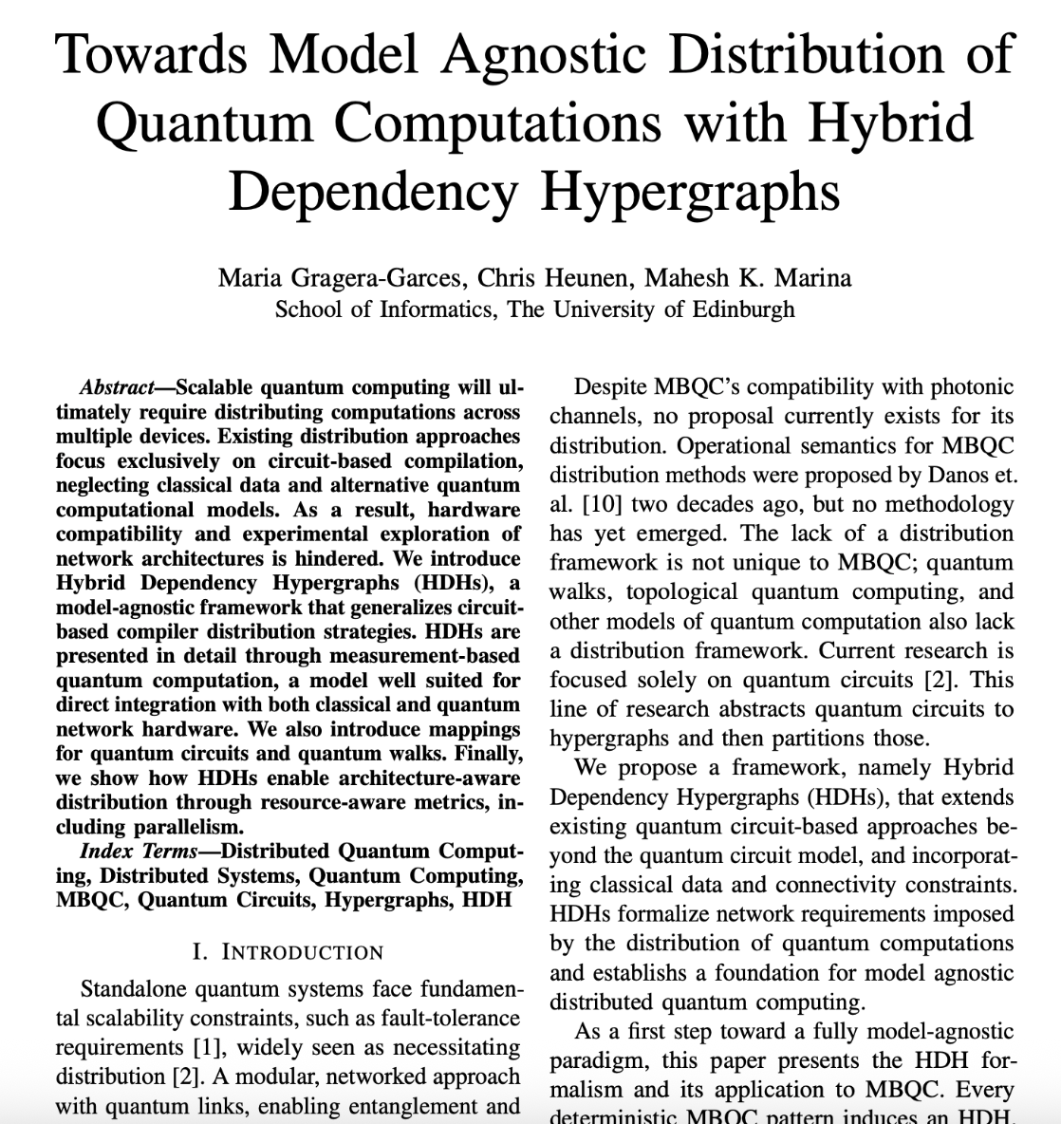
The shameless plug: HDH package
pip install hdh
Under construction ☺ ETA: September
Model agnostic
Consider telegate and teledata simulateneously
Backwards compatible with QASM and Qiskit monolithic codes
Maria Gragera Garces | WERSHOP 2025 | NYU

Slide 42
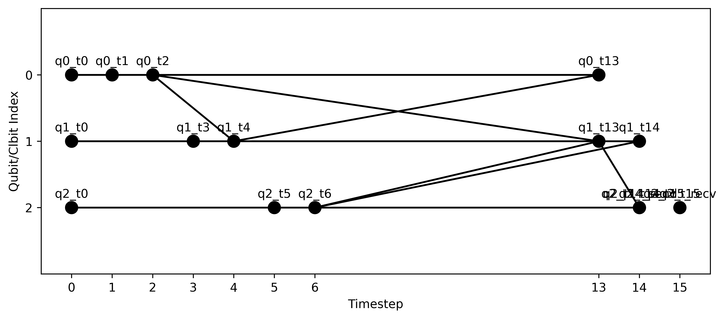
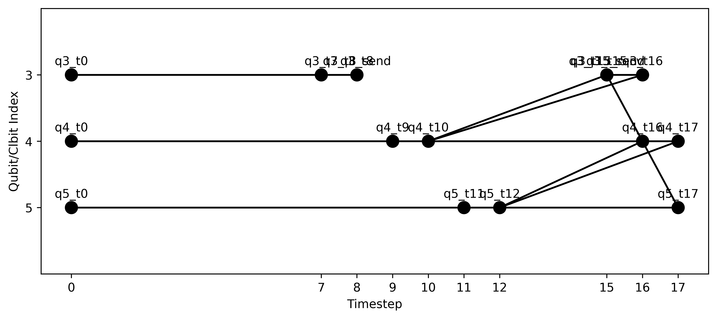
hdh = from_qiskit(qc)
hdh_cut = compute_cut(hdh, num_parts = 2)
Monolithic Qiskit code
HDH partitioning
Distributed Qiskit code
EM implementation
Device tests
Maria Gragera Garces | WERSHOP 2025 | NYU

Slide 43
hdh = from_qiskit(qc)
cut_qc = cut_and_rewrite_hdh(hdh, num_parts = 2)
Monolithic Qiskit code
HDH partitioning
Distributed Qiskit code
EM implementation
Device tests
Additional teleportation channel error injections
Maria Gragera Garces | WERSHOP 2025 | NYU

Slide 44
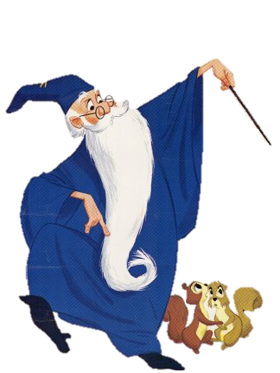

Monolithic Qiskit code
HDH partitioning
Distributed Qiskit code
EM implementation
Device tests
Error mitigation software!
Maria Gragera Garces | WERSHOP 2025 | NYU

Slide 45

Monolithic Qiskit code
HDH partitioning
Distributed Qiskit code
EM implementation
Simulation tests
Maria Gragera Garces | WERSHOP 2025 | NYU

Slide 46
Distribution-Aware QEM
How should the field move forward?
More work on distributed error profiling both on simulated (large memory requirements for large systems) and real devices (few/none usable distributed quantum computers today)
Testing error mitigation and correction techniques in distributed setups (suffers from the same issues as above)
Development of error mitigation and error correction software that is distribution aware
Maria Gragera Garces | WERSHOP 2025 | NYU

Slide 47
“if you are building things for tomorrow’s quantum computers you are building things for distributed quantum computers”
Thanks!
Maria Gragera Garces | WERSHOP 2025 | NYU

